Slide 1

Project_1_JMB_Portfolio
Project collaborators:
Josina Marilia Baiao (github.com/JosinaB)
Sean Endicott (github.com/seane13)
Oscar Lopez (github.com/Maurolp15)
Fabrice Solomon (github.com/fsalomon496)

Slide 2
Project Triggers and Objectives
JMB Portfolio is the personal portfolio of a retail trader. Project_1_JMB_Portfolio is a collaborative project which analyzes the past performance and forecast future performance of each individual stock in the portfolio, to optimize daily positional adjustments (buy, sell hold). It By evaluating the volatility, risk and return of each stock through complementary technical analyzes, key results will be derived to help lower risk exposure and optimize gains, to better position the portfolio to meet a 20% monthly return that will be withdrawn and used as personal income.
The portfolio will maintain a $100,000 USD cash investment diversified between the following 5 stocks: Amazon (AMZN), FB (FACEBOOK), NVidia (NVDA), Walmart (WMT) and Goldman Sachs (GS). The project is written on a Jupyter lab notebook using Python, Pandas and Pyviz. Historical data for stocks reach back 1 year and forecast predictions are calculated for 1 month forward.
In order to achieve the set objective, the following fundamental questions were posed to ascertain risk factors, the growth potential and the ideal composition of the portfolio:
How stable or volatile are these stocks?
How do they perform on average in relation to the S&P 500?
Are there any particular factors of risk that the trader should be mindful of?
Did the socio-economic environment, particularly the pandemic, impact it’s overall performance? Was the performance of these stocks highly impacted by COVID?
What were the average net changes of these stocks on an annualized basis?
In order to mitigate risk and volatility, and yield the expected minimum return of 20%, what would be the optimal distribution of these stocks within the portfolio?

Slide 3
Questions & Data
The 5 stocks in the portfolio were selected from an initial list of 30, based on the following criteria:
Stocks from diverse sectors (consumer services, financial and technology), with average price movements greater than 1USD/day, with an overall upward trend line of its price over the last 52 weeks, with room to reach annual price high and with high trading volumes.
News from leading analysts and information from earnings reports indicating sound and sustainable financial health and continued growth potential.
The data needed to define and evaluate the portfolio was sourced from the Python libraries, particularly the Alpaca Trading Api package. It included the daily open, high, low and closing prices, trading volumes, stock ticker reference data and overall market indicators of the S&P 500 from January 28th, 2021 through February 7th , 2022.
Used Python, Anaconda/ Pandas, Jupyter Lab, Pyviz
Data/metrics determined as needed to evaluate the portfolio:
Daily closing price
Daily return
Covariance against the S&P 500
Volatility
Correlation
Standard deviation
Beta
Simple Moving Average
Exponentially Weighted Moving Average
Rolling statistics
Sharpe Ratio
Monte Carlo Simulation

Slide 4

Findings Summary
After evaluating the data and running the calculations, the project team concluded that there is a 95% chance that an initial investment of $100,000 in the portfolio over the next 30 days will end within the range of $86,863.46 and $115,850.86 with a potential loss of 13,136.54 or a potential profit of 15,850.86, yielding a 15.8% return which falls short of meeting the 20% goal.
The team feels that more data and analysis is needed to fine tune the results and optimize the portfolio, Nevertheless, it appreciated the opportunity to work on a such a critical tool for a day trader.

Slide 5
Data Cleanup and Exploration
Alpaca did not provide adjusted closing prices - it would be interesting to get this type info next time, to fine tune the results;
Correlation was only ran between S&P 500 and Amazon as a template to not over inflate the project;
Need more tools to thoroughly advise on this portfolio as a day trade portfolio;
Could have cleaned and organized the data more efficiently, perhaps created more variables, etc.;
The portfolio wants to draw a monthly income so the data was kept on shorter time frames and adjusted the MC sims probability calculations
calculate an average from the simulations in conjunction with the extremes and adjust the projected gains and/ or past gains to reflect a change in both directions to simulate short positions;
Moving forward, can also incorporate a trading performance adjustment. This analyzer shows past stock performance and future projections..
The performance of the day trader in mathematical terms would be a valuable variable in this equation

Slide 6
Data Analysis
Steps taken to analyze the data and answer each question in the proposal – using Python, Anaconda/ Pandas, Jupyter Lab, Pyviz, one year’s worth of data for all stocks and the S&P 500 was imported into a Jupyter lab notebook, it was cleaned by closing prices, and the following operations, calculations and associated graph plotting were performed
Created dataframes for daily and cumulative returns, which in turn were used to calculate the statistical indicators Mean and Standard Deviation of daily returns;
The distributions of the percentage change in the daily returns of each stock were calculated and plotted on a histogram;
Closing prices as well as rolling 7-day Mean and Standard Deviation of daily prices for all stocks were also plotted;
The rolling 180-day Mean of closing prices were also plotted with the 30 day closing prices;
Scatterplot of Amazon vs S&P
Calculated the covariance of Amazon vs S&P 500
Calculated the variance of S&P 500
Calculated the Beta of all daily returns of Amazon
Calculated the cumulative returns of all stocks
Calculated the annualized volatility of all stocks
Calculated the correlation of all the stocks
Calculated the cumulative portfolio returns
Calculated the annualized Sharpe Ratio
Ran Monte Carlo simulations forecasting 1 and 5 years of cumulative returns
Plotted the Monte Carlo simulation outcomes
Finally, with the summary statistics from the Monte Carlo simulation results, the range of the possible outcomes of the $100,000 investment in the portfolio was calculated using the lower and upper `95%` confidence intervals.

Slide 7
Data Analysis (continued)
Answers to the questions asked in the proposal:
How stable or volatile are these stocks?
For the studied period, these stocks are mostly stable and have had relatively low annualized volatility, between 0.16 and 0.39, except for NVidia which has a 0.87 value, showing a higher price risk due to its higher fluctuation.
How do they perform on average in relation to the S&P 500?
Individually, these stocks performed below the level of return of the market which was 21.57% for the 52-week period ending in January 2022, and their returns oscillated between 2.86% (Walmart) and 13.46% (Amazon).
Are there any particular risk factors that the trader should be mindful of?
The higher volatility of NVidia should perhaps be mitigated by attributing a lower weight to it of the number of positions in the portfolio.
What were the average net changes of these stocks on an annualized basis?
In order to mitigate risk and volatility, and yield the expected minimum return of 20%, what would be the optimal distribution of these stocks within the portfolio?
The analysis of the portfolio assumed an equal distribution of 20% of each stock. Since Nvidia and FB showed higher risk profiles, one recommendation is to reduce 10% of each of these stocks and redistribute it pro-rata to the other ones, resulting in lower risk exposure to these two stocks but potentially impacting returns negatively since NVidia has the second best performance of the portfolio, after Amazon.

Slide 8
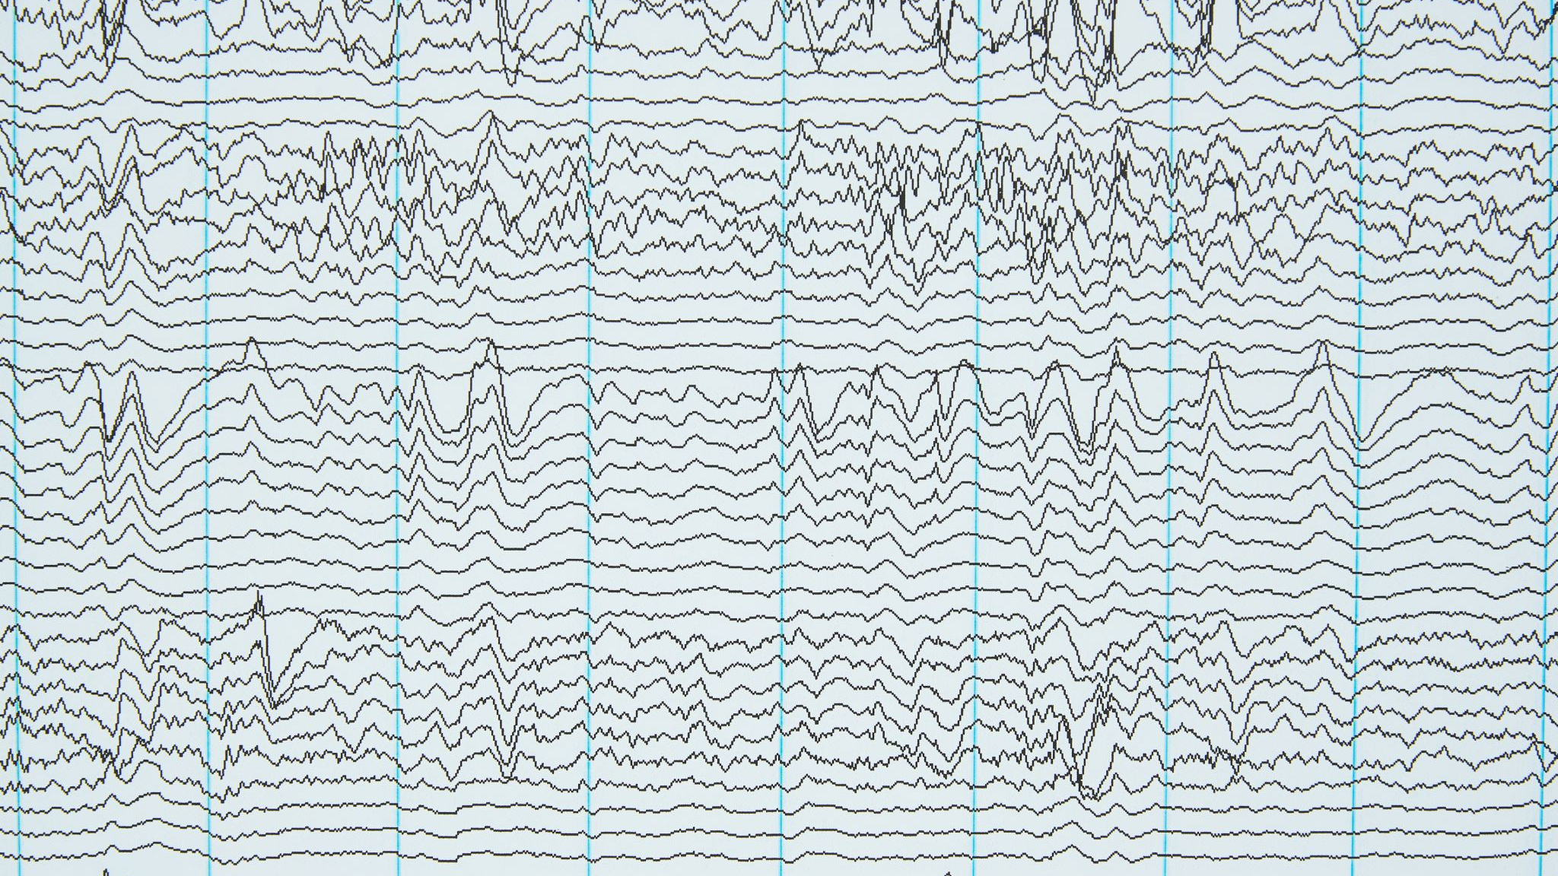
Data Analysis (continued)
Live presentation of some the most representative tables, graphs, plots – Jupyter Notebooks:
Project_Dashboard.ipynb
proj_1.ipynb

Slide 9
Conclusions
Summarize your conclusions. This should include a numerical summary (i.e., what data did your analysis yield), as well as visualizations of that summary (plots of the final analysis data).
Tickers used (AMZN, FB, NVDA, WMT, GS, and SNP)
We used the following metrics to give a better insight on stocks within my portfolio and how they are performing:
Standard Deviation
Cumulative return,
Monte Carlo,
Annualized volatility, correlation,
Covariance of S&P 500, Including Beta
Exponentially MVA,
Sharpe Ratio

Slide 10
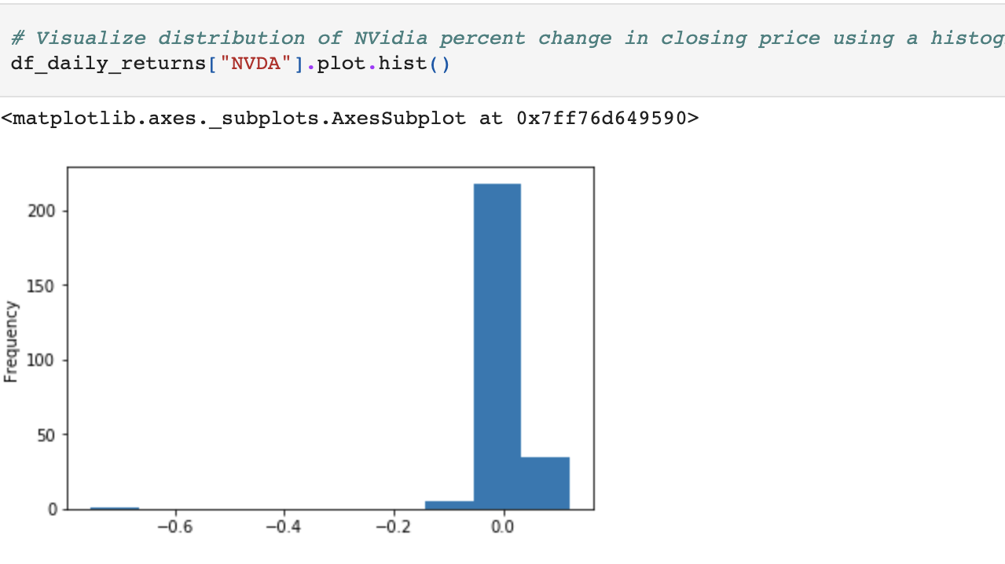
Standard Deviation
Standard deviation helps determine market volatility or the spread of asset prices from their average price. When prices move wildly, standard deviation is high, meaning an investment will be risky. Low standard deviation means prices are calm, so investments come with low risk.
NVDA is the most volatile stock in our portfolio with a std of (0.0552). Compared to the other tickers this was the highest standard deviation shown. The lowest was WMT coming in at (0.0106)

Slide 11
Covariance against the S&P 500
The covariance helps to determine the how the mean values of two stocks or market indexes move together or in the opposite direction. When compared against the S&P 500, it helps to determine how specific securities prices move, in relation to the market price movements. It can be positive or negative.
If stock A's return moves higher whenever stock B's return moves higher and the same relationship is found when each stock's return decreases, then these stocks are said to have positive covariance and it can be a good indicator for stock behavior predictability. For stocks with negative covariance, this can be helpful for composing a portfolio with stocks that complement each other in terms of price movement as it helps mitigate risk and volatility in the portfolio and guarantee that no matter which direction prices are moving there are securities in the portfolio yielding positive returns .

Slide 12
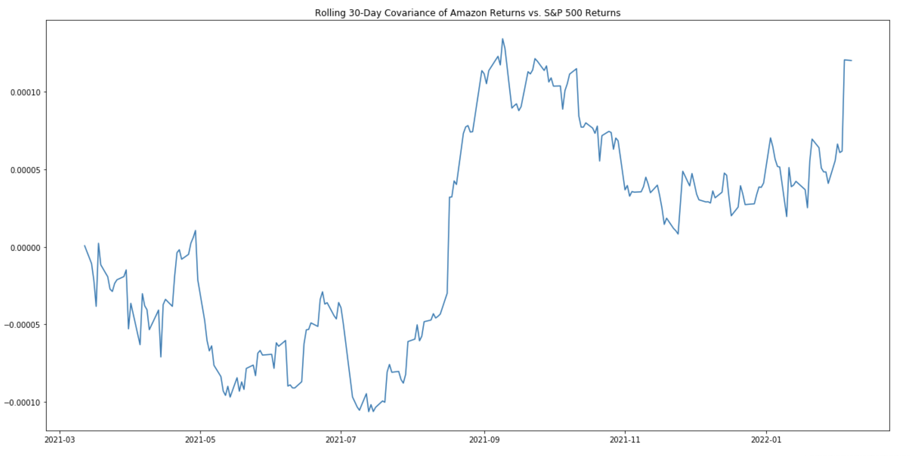
Covariance against the S&P 500

Slide 13
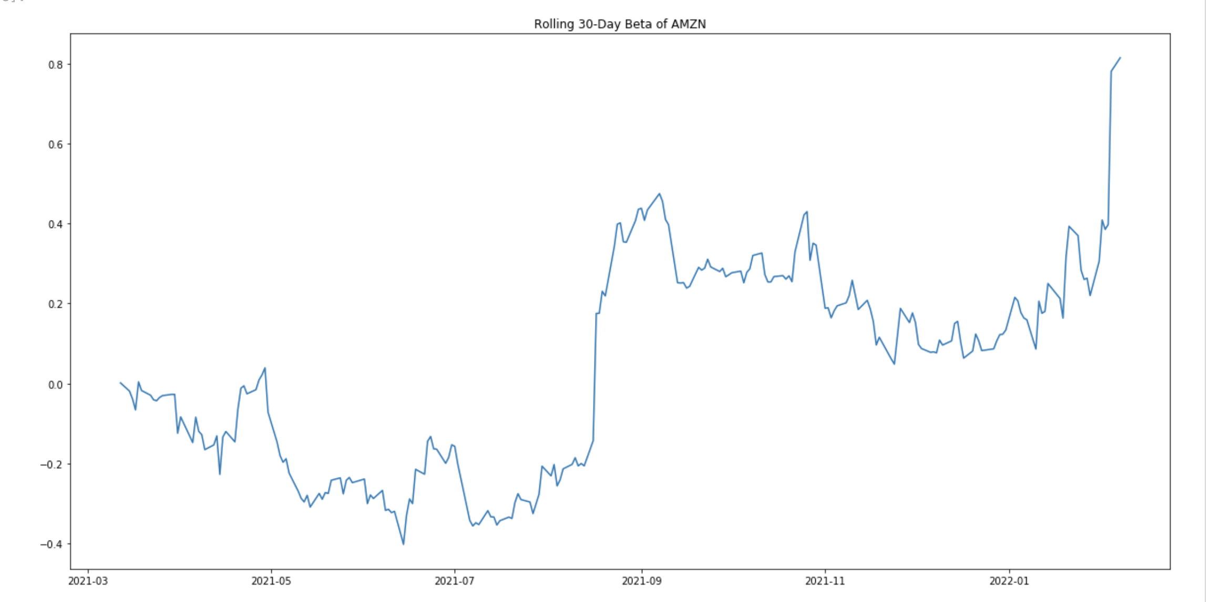
Beta
Beta is a concept that measures the expected move in a stock relative to movements in the overall market. The market has a beta of 1. A beta greater than 1.0 suggests that the stock is more volatile than the broader market, and a beta less than 1.0 indicates a stock with lower volatility.
AMZN is more volatile than the average market.

